Slide 1
Google Search Engine Using RPA
PIP2001 Capstone Project
Review-4
Batch Number:
Under the Supervision of,
Ms.Sterlin Minish T N
Assistant Professor
School of Computer Science and Engineering
Presidency University
Roll Number 20211CIT0036 20211CIT0192 20211CIT0167 | Student Name Uluva Anji Chamanthula Hemanth Shaik Sadhik
Name of the Program:
Name of the HoD: Dr. Anandaraj S P
Name of the Program Project Coordinator: Dr. Sharmasth Vali Y
Name of the School Project Coordinators: Dr. Sampath A K / Dr. Abdul Khadar A / Mr. Md Ziaur Rahman

Slide 2
Introduction
In today’s digital age, information retrieval has become a critical component of decision-making processes across various domains. However, searching for specific information on platforms like Google often yields results that are poorly structured and challenging to consume. Users are frequently required to invest significant time and effort drilling down into each link to extract relevant details, leading to inefficiencies in information gathering.
This project aims to address these challenges by automating the Google search process using Robotic Process Automation (RPA) techniques. By leveraging tools such as UiPath and Selenium, our solution will streamline the extraction of search results and present the information in a well-organized, tabular format, similar to that found in online directories like Just Dial. For instance, when searching for "Chinese Restaurants in Coimbatore," the project will automate the collection of essential details such as restaurant names, addresses, contact information, and user ratings.
The core objective of this project is to enhance the user experience by transforming unstructured search results into structured data that is easily consumable. This automation not only saves time but also reduces manual effort, allowing users to access pertinent information swiftly and efficiently. Ultimately, this project represents a significant step towards making information retrieval more user-friendly and efficient in the vast landscape of the internet.

Slide 3
Literature Review
sno | Author Name | Title | Publication Date | Summary | Extracted Information
1 | Najah Mary El-Gharib,Daniel Amyo | Robotic process automation using process mining | 2023 | This paper reviews the integration of process mining (PM) with RPA to identify automatable tasks from event logs, highlighting challenges in preprocessing and gaps in automation lifecycle support. | We extracted techniques for identifying automatable tasks through event log analysis and process discovery** to streamline Google search result automation in our project.
2 | Alok Mani Tripathi | Built real-world RPA solution using UIPath and Automation Anywhere | 2020 | A beginner’s guide to RPA using UiPath, focusing on automating tasks, deploying bots, and integrating with popular applications. | We extracted UiPath automation techniques for data extraction and bot deployment to structure Google search results into a table format for our project.
3 | Sumit Kumar, Uponika Barman Roy | Literature review on the sustainable implementation of Robotic Process Automation (RPA) | 2024 | This paper explores how RPA reduces administrative burdens in healthcare, emphasizing sustainability and identifying research gaps in implementation and governance. | We extracted insights on the administrative efficiency gains from RPA implementation in healthcare, which inform our approach to automating data extraction and organization in our Google search project.
4
5
6

Slide 4
sno | Author Name | Title | Published year | Summary | Information extracted
4 | J. A. P,A. Shankar,A. N. JR | Robotic Process Automation: In-Depth Analysis of Advanced Automation Techniques and Technologies | 2024. | This paper analyzes Robotic Process Automation (RPA), discussing its applications, benefits, challenges, and ethical implications while highlighting its integration with cognitive technologies and role in Industry 4.0. | We extracted insights on hyper-automation and cognitive technology integration from RPA, which will enhance our project's efficiency in automating data retrieval and processing Google search results.
5 | Axmann,H. Harmoko | Robotic Process Automation: An Overview and Comparison to Other Technology in Industry 4.0." | 2020 | This paper reviews Robotic Process Automation (RPA), outlining its types (attended, unattended, hybrid), benefits, and limitations while comparing its efficiency and integration costs to other Industry 4.0 technologies. | We extracted insights on the types of RPA (attended, unattended, hybrid) and their applications across various departments, which will guide our approach in effectively automating data extraction and processing for Google search results in our project. 4o mini

Slide 5
sno | Author Name | Title | Published year | summary | Information Extracted
6 | Z. Huang,Y. Dou | A Robotic Process Automation Data Collection Method Based on Web Content Structure Recognition. | 2022 | This paper introduces the WCSR framework for Robotic Process Automation, enhancing data collection from diverse web sources through intelligent content structure recognition, achieving high accuracy and efficiency. | We extracted the WCSR framework for improving data collection from web sources, which will aid in effectively gathering and organizing Google search results for our project.
7 | Not specified in the abstract (refer to the full paper for details) | A Comparative Study of RPA Tools: Automation Anywhere, UiPath, and BluePrism | 2023 | This paper discusses RPA as a means to automate repetitive tasks and compares three major RPA platforms for their effectiveness in business process automation | Insights on the functionalities of Automation Anywhere, UiPath, and BluePrism to inform our selection of tools for implementing RPA in our project.

Slide 6
Existing method Drawback
Manual Search and Filtering
Time-Consuming: Users spend significant time browsing through multiple search results to find relevant information.
Inefficient: High reliance on user judgment can lead to inconsistent results and missed relevant data.
Unstructured Data: Search results are presented in an unorganized manner, making it difficult to extract and utilize information effectively.
Directory-Based Search (e.g., JustDial)
Limited Scope: While directories provide structured data, they are limited to specific categories and may not cover all user queries.
Dependence on Directory Availability: Users are restricted to the information available within the directory, lacking the breadth of search engines like Google.
These drawbacks highlight the need for an automated solution that combines the comprehensive search capabilities of Google with the structured data presentation of directories.

Slide 7
Proposed Methodology
To address the identified drawbacks, the following method is proposed:
RPA Tool Selection: Utilize an RPA tool such as UiPath or Blue Prism to automate the Google search process.
Automated Search Execution: The RPA bot will input user-defined queries into Google and retrieve the top 10-20 search results.
Web Scraping: Extract essential information from each search result, including the URL, title, and a brief description.
Data Structuring: Organize the extracted data into an Excel spreadsheet with clearly defined columns for easy readability and analysis.
Output Generation: Save the structured data in a specified format (e.g., Excel or Google Sheets) for user access and further processing.
This method eliminates the need for manual data extraction and structuring, providing users with a ready-to-use dataset derived from Google search results.

Slide 8
Objectives
1. Automation of Web Search
Develop an efficient system to automate Google searches and extract relevant data with minimal manual intervention.
2. Data Extraction and Organization
Retrieve and structure key information such as titles, links, descriptions, and metadata for user-friendly presentation.
3. Integration of Frontend and Backend
Create a seamless interaction between user inputs and automated backend processes using Flask.
4. User-Friendly Interface
Provide a simple and intuitive web interface for users to perform automated searches.
5. Efficiency and Scalability
Enhance the speed and reliability of the data extraction process, with potential scalability for larger datasets or multiple search engines.

Slide 9
Methodology/Modules
Step :- 1 Problem Identification
Automate the process of web search and data extraction to save time and effort.
Step :- 2 Requirement Analysis
Identify necessary hardware (computer/laptop) and software tools (Python, Flask, Selenium, BeautifulSoup).
Step :- 3 Design Architecture
Create a frontend web interface for user input and display results.
Develop a backend system for automating search and data processing.
Step :- 4 Development Steps
Frontend Development: Design a user-friendly input form using HTML and CSS.
Backend Automation:
Use Selenium to perform Google searches programmatically.

Slide 10
Continued…
Employ BeautifulSoup to extract links, titles, and descriptions from search results.
Integrate Flask to connect frontend inputs with backend processes.
Step :- 5 Testing and Validation
Test individual modules (e.g., search automation, data extraction, UI responsiveness).
Validate the extracted data for accuracy and relevance.
Step :- 6 Deployment
Host the application locally for testing purposes.
Deploy on a cloud platform for public access if needed.
Step :- 7 Enhancements
Incorporate advanced features like exporting results to files (CSV/Excel).
Extend the application to scrape data from additional platforms or search engines.

Slide 11
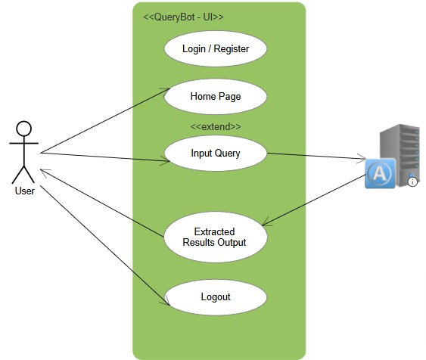
Architecture

Slide 12
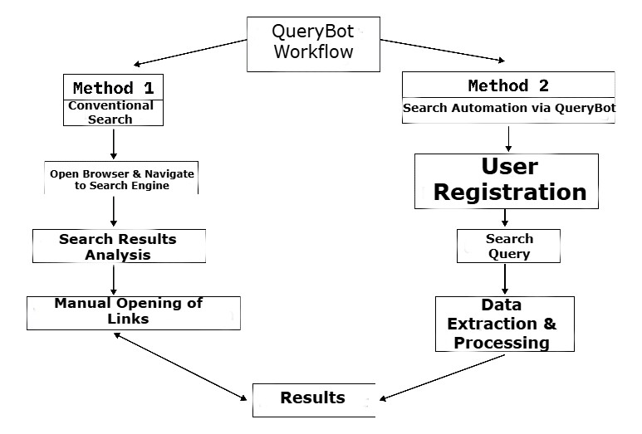
Working Model

Slide 13
Hardware/software components
Software Requirements
RPA Tool: UiPath or Blue Prism for automation tasks.
Web Browser: Google Chrome or Mozilla Firefox for executing search operations.
Spreadsheet Software: Microsoft Excel or Google Sheets for data storage.
Programming Environment: Python (optional, for any additional scripting needs).
These requirements ensure that the automation process runs smoothly without hardware or software bottlenecks.

Slide 14
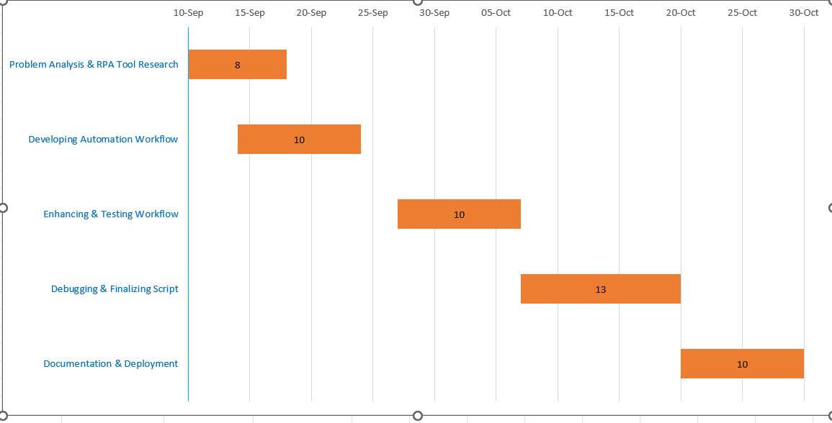
Timeline of Project

Slide 15
Expected Outcomes
The main outcome of this project is the successful automation of Google search result processing. Using Robotic Process Automation (RPA), the project extracts relevant information from search results and structures it into an easily consumable format (such as an Excel sheet or table). This automation reduces the time and manual effort needed to sift through web pages, making the entire process more efficient and user-friendly. The tool developed can be adapted for various search queries, making it useful in research, marketing, and business data gathering.
Reduction in Manual Effort: Eliminates the need for users to manually browse through search links to extract information.
Time Efficiency: Results are presented in a structured format (table or Excel) instantly, saving significant time.
Scalability: Can be adapted for different search queries and scaled to handle a large volume of search results.
Accuracy: RPA reduces the possibility of human error in data extraction.

Slide 16
Conclusion
This project demonstrates how RPA can be leveraged to automate and optimize the process of extracting and organizing Google search results. By mimicking manual browsing and data extraction processes, the RPA tool offers a reliable and scalable solution that minimizes user effort and maximizes time efficiency. The project is especially relevant for businesses, researchers, and digital marketers who need to extract structured data from search engines. This automated system can significantly reduce operational costs, increase productivity, and improve data accuracy, offering a sustainable alternative to manual search result processing.
The successful deployment of this tool showcases the potential of RPA in streamlining data-related tasks across multiple domains, including business intelligence, research, and online marketing. Future work can involve enhancing the tool’s capabilities by integrating machine learning to refine the extracted data based on user preferences.

Slide 17
Github Link
The Github link provided should have public access permission.
Github Link:
https://github.com/Anjiuluva7/Google-Search-Engine-Using-RPA-/tree/master

Slide 18
References
Mehta, R., & Chaher, R. (2022). Implementation of Robotic Process Automation (RPA) in Digital Marketing. 2022 3rd International Conference for Emerging Technology (INCET). IEEE.
This paper discusses the role of RPA in automating digital marketing processes, which aligns with your project’s focus on automating data extraction tasks.
Patrício, L., Costa, C. R. de S., Varela, L., & Cruz-Cunha, M. M. (2024). Literature review on the sustainable implementation of Robotic Process Automation (RPA) in medical and healthcare administrative services. Procedia Computer Science, 239, 166.
The paper provides insights into the sustainable application of RPA, relevant for understanding the broader implications of automation in administrative processes.
Geyer-Klingeberg, J., Nakladal, J., Baldauf, F., & Veit, F. (2018). Process mining and Robotic Process Automation: A perfect match. cognitiveX Blog.
This article explains how RPA can work alongside process mining to enhance efficiency, directly applicable to your Google search automation project.

Slide 19
Agostinelli, S., Marrella, A., & Mecella, M. (2019). Research challenges for Robotic Process Automation. ICPM 2019 - IEEE International Conference on Process Mining. IEEE.
This paper highlights the current challenges in RPA implementation, providing useful context for refining your project's methodology.
"A Comparative Analysis of Automation Anywhere, UiPath, and Blue Prism" https://ieeexplore.ieee.org/document/10182777
APA Citation: Author(s). (Year). A comparative analysis of Automation Anywhere, UiPath, and Blue Prism. IEEE
Xplore. https://ieeexplore.ieee.org/document/10182777
"Effectiveness of Robotic Process Automation for Data Mining Using UiPath" https://ieeexplore.ieee.org/document/9396024
APA Citation: Author(s). (Year). Effectiveness of robotic process automation for data mining using UiPath.
IEEE Xplore. https://ieeexplore.ieee.org/document/9396024

Slide 20
https://www.researchgate.net/publication/373845876_A_Systematic_Review_of_Robotic_Process_Automation_in_Business_Operations_Contemporary_Trends_and_Insights
https://www.researchgate.net/publication/382613045_Literature_review_on_the_sustainable_implementation_of_Robotic_Process_Automation_RPA_in_medical_and_healthcare_administrative_services
https://www.researchgate.net/publication/326466901_Process_Mining_and_Robotic_Process_Automation_A_Perfect_Matchhttps://www.researchgate.net/publication/326466901_Process_Mining_and_Robotic_Process_Automation_A_Perfect_Match
https://www.researchgate.net/publication/338352191_Research_Challenges_for_Intelligent_Robotic_Process_Automation
https://ieeexplore.ieee.org/document/10182777
https://ieeexplore.ieee.org/document/9396024

Slide 21

Project work mapping with SDG

Slide 22
Thank You

